Slide 1
String handling

Slide 2
introduction
Java implements strings as objects of type string. This helps in building efficient string handling functions.
String objects are immutable:
Each time you change the contents of the object a new object is created and object values cannot be changed.
Mutable objects can be created using StringBuffer and StringBuilder.
All three classes are declared as final, so they don’t contain subclasses.
They implement CharSequence interface.

Slide 3
String constructors
To create empty String
String s= new String();
To create String initialized with array of characters.
String(char chars[ ])
Here is an example:
char chars[] = { 'a', 'b', 'c' };
String s = new String(chars);
This constructor initializes s with the string “abc”.
To create subrange of a character array as an initializer
String(char chars[ ], int startIndex, int numChars)
startIndex specifies the index at which the subrange begins, and numChars specifies the number of characters to use.
Here is an example:
char chars[] = { 'a', 'b', 'c', 'd', 'e', 'f' };
String s = new String(chars, 2, 3);
This initializes s with the characters cde.

Slide 4
String constructors(contd..)
construct a String object that contains the same character sequence as another String object .
String(String strObj)
Here, strObj is a String object.
Consider this example:
// Construct one String from another.
class MakeString {
public static void main(String args[]) {
char c[] = {'J', 'a', 'v', 'a'};
String s1 = new String(c);
String s2 = new String(s1);
System.out.println(s1);
System.out.println(s2);
}
}
Output: Java Java

Slide 5
String constructors(contd..)
Using ASCII Character Set
String(byte asciiChars[ ])
String(byte asciiChars[ ], int startIndex, int numChars)
asciiChars specifies the array of bytes.
The byte-to-character conversion is done by using The default character encoding of the platform.

Slide 6
String constructors(contd..)
Using ASCII Character Set(Contd..)
EX:
// Construct string from subset of char array.
class SubStringCons {
public static void main(String args[]) {
byte ascii[] = {65, 66, 67, 68, 69, 70 };
String s1 = new String(ascii);
System.out.println(s1);
String s2 = new String(ascii, 2, 3);
System.out.println(s2);
}
}
Output:
ABCDEF
CDE

Slide 7
String constructors(contd..)
String from StringBuffer.
String(StringBuffer strBufObj)
J2SE 5 added two constructors to String
String(int codePoints[ ], int startIndex, int numChars)
String(StringBuilder strBuildObj)

Slide 8
String length
The length of a string is the number of characters that it contains.
int length( )
EX: char chars[] = { 'a', 'b', 'c' };
String s = new String(chars);
System.out.println(s.length());
//output: 3

Slide 9
Special string operations
The automatic creation of new String instances from string literals.
Concatenation of multiple String objects by use of the + operator.
The conversion of other data types to a string representation.

Slide 10
Special string operations(contd..)
String Literals
String s2 = "abc";
Java automatically constructs a String object. Thus, you can use a string literal to initialize a String object.
String object is created for every string literal, you can use a string literal any place you can use a String object.
System.out.println("abc".length()); // Valid Function on string Literal Directly.

Slide 11
Special string operations(contd..)
String Concatenation
+ operator is used to concatenate the string.
String age = "9";
String s = "He is " + age + " years old.";
System.out.println(s);

Slide 12
Special string operations(contd..)
String Concatenation with Other Data Types.
String s = "four: " + 2 + 2;
System.out.println(s);
String s = "four: " + (2 + 2);

Slide 13
Special string operations(contd..)
String Conversion and toString( )
Every class implements toString( ) because it is defined by Object.
If you want to override toString( ) and provide your own string representations.
Public String toString( )

Slide 14
Character extraction
The String class provides a number of ways in which characters can be extracted from a String object.
charAt( )
To extract a single character from a String, you can refer directly to an individual character via the charAt( ) method. It has this general form:
char charAt(int where)
Where, is the index of the character that you want to obtain. The value of where must be nonnegative and specify a location within the string.
charAt( ) returns the character at the specified location.
For example,
char ch;
ch = "abc".charAt(1);
assigns the value “b” to ch.

Slide 15
Character extraction(contd..)
getChars( )
to extract more than one character at a time.
void getChars(int sourceStart, int sourceEnd, char target[ ], int targetStart)
sourceStart specifies the index of the beginning of the substring.
sourceEnd specifies an index that is one past the end of the desired substring.
the substring contains the characters from sourceStart through sourceEnd. The array that will receive the characters is specified by target.
The index within target at which the substring will be copied is passed in targetStart.
Care must be taken to assure that the target array is large enough to hold the number of characters in the specified substring.

Slide 16
Character extraction(contd..)
getChars( ) (Contd..)
EX:
class getCharsDemo {
public static void main(String args[]) {
String s = "This is a demo of the getChars method.";
int start = 10;
int end = 14;
char buf[] = new char[end - start];
s.getChars(start, end, buf, 0);
System.out.println(buf);
}
}
output is: demo

Slide 17
Character extraction(contd..)
getBytes()
There is an alternative to getChars( ) that stores the characters in an array of bytes.
it uses the default character-to-byte conversions provided by the platform.
Here is its simplest form:
byte[ ] getBytes( )
getBytes( ) is most useful when you are exporting a String value into an environment that does not support 16-bit Unicode characters.
Notes:
String val1=“Hello World”;
Byte[] a=val1.getBytes();
For(byte b:a)
s.o.pln(b+”-”);
//Prints Byte Equivalent of each character in Hello World.

Slide 18
Character extraction(contd..)
toCharArray( )
to convert all the characters in a String object into a character array.
It returns an array of characters for the entire string.
It has this general form:
char[ ] toCharArray( )
getChars( ) can be used to achieve the same result.

Slide 19
String Comparison
equals( ) and equalsIgnoreCase( )
To compare two strings for equality.
It has this general form:
boolean equals(Object str)
Here, str is the String object being compared with the invoking String object.
It returns true if the strings contain the same characters in the same order, and false otherwise.
The comparison is case-sensitive.
To perform a comparison that ignores case differences, call equalsIgnoreCase( ).
it considers A-Z to be the same as a-z.
It has this general form:
boolean equalsIgnoreCase(String str)
Here, str is the String object being compared with the invoking String object.
Returns true if the strings contain the same characters in the same order, and false otherwise.

Slide 20
String Comparison(contd..)
equals( ) and equalsIgnoreCase( )(contd..)
class equalsDemo {
public static void main(String args[]) {
String s1 = "Hello";
String s2 = "Hello";
String s3 = "Good-bye";
String s4 = "HELLO";
System.out.println(s1 + " equals " + s2 + " -> " +s1.equals(s2));
System.out.println(s1 + " equals " + s3 + " -> " +s1.equals(s3));
System.out.println(s1 + " equals " + s4 + " -> " +s1.equals(s4));
System.out.println(s1 + " equalsIgnoreCase " + s4 + " -> " +s1.equalsIgnoreCase(s4));
}
}

Slide 21
String Comparison(contd..)
equals( ) and equalsIgnoreCase( )(contd..)
The output from the program is shown here:
Hello equals Hello -> true
Hello equals Good-bye -> false
Hello equals HELLO -> false
Hello equalsIgnoreCase HELLO -> true

Slide 22
String Comparison(contd..)
regionMatches( )
The regionMatches( ) method compares a specific region inside a string with another specific region in another string.
There is an overloaded form that allows you to ignore case in such comparisons.
Here are the general forms for these two methods:
boolean regionMatches(int startIndex, String str2,int str2StartIndex, int numChars)
boolean regionMatches(boolean ignoreCase,int startIndex, String str2,int str2StartIndex, int numChars)
startIndex specifies the index at which the region begins within the invoking String object.
The String being compared is specified by str2.
The index at which the comparison will start within str2 is specified by str2StartIndex.
The length of the substring being compared is passed in numChars.
In the second version, if ignoreCase is true, the case of the characters is ignored. Otherwise, case is significant.

Slide 23
String Comparison(contd..)
startsWith( ) and endsWith( )
The startsWith( ) method determines whether a given String begins with a specified string.
endsWith( ) determines whether the String in question ends with a specified string.
They have the following general forms:
boolean startsWith(String str)
boolean endsWith(String str)
Here, str is the String being tested. If the string matches, true is returned. Otherwise, false is returned.
For example,
"Foobar".endsWith("bar")
and
"Foobar".startsWith("Foo")
are both true.
A second form of startsWith( ), shown here,
boolean startsWith(String str, int startIndex)
Here, startIndex specifies the index into the invoking string at which point the search will begin.
For example,
"Foobar".startsWith("bar", 3)
returns true.

Slide 24
String Comparison(contd..)
equals( ) Versus ==
the equals( ) method compares the characters inside a String object.
The == operator compares two object references to see whether they refer to the same instance.
class EqualsNotEqualTo {
public static void main(String args[]) {
String s1 = "Hello";
String s2 = new String(s1);
System.out.println(s1 + " equals " + s2 + " -> " +
s1.equals(s2));
System.out.println(s1 + " == " + s2 + " -> " + (s1 == s2));
}
}
Output: Hello equals Hello -> true
Hello == Hello -> false

Slide 25
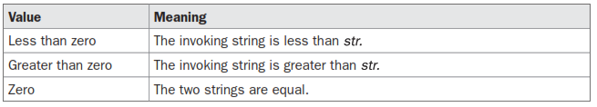
String Comparison(contd..)
compareTo( )
It has this general form:
int compareTo(String str)

Slide 26
String Comparison(contd..)
compareTo( ) (contd..)
class SortString {
static String arr[] = {
"Now", "is", "the", "time", "for", "all", "good", "men",
"to", "come", "to", "the", "aid", "of", "their", "country"
};
public static void main(String args[]) {
for(int j = 0; j < arr.length; j++) {
for(int i = j + 1; i < arr.length; i++) {
if(arr[i].compareTo(arr[j]) < 0) {
String t = arr[j];
arr[j] = arr[i];
arr[i] = t;
}
}
System.out.println(arr[j]);
}}} //Output: Elements in sorted Order.

Slide 27
String Comparison(contd..)
compareTo( ) (contd..)
If you want to ignore case differences when comparing two strings, use compareToIgnoreCase( ), as shown here:
int compareToIgnoreCase(String str)

Slide 28
Searching strings
The String class provides two methods that allow you to search a string for a specified character or substring:
indexOf( ) Searches for the first occurrence of a character or substring.
lastIndexOf( ) Searches for the last occurrence of a character or substring.
To search for the first occurrence of a character,
int indexOf(char ch)
To search for the last occurrence of a character, use
int lastIndexOf(char ch)
To search for the first or last occurrence of a substring,
int indexOf(String str)
int lastIndexOf(String str)

Slide 29
Searching strings(contd..)
You can specify a starting point for the search
int indexOf(char ch, int startIndex)
int lastIndexOf(char ch, int startIndex)
int indexOf(String str, int startIndex)
int lastIndexOf(String str, int startIndex)
EX:
class indexOfDemo {
public static void main(String args[]) {
String s = "Now is the time for all good men to come to the aid of their country.";

Slide 30
Searching strings(contd..)
System.out.println("indexOf(t) = " + s.indexOf('t'));
System.out.println("lastIndexOf(t) = " +s.lastIndexOf('t'));
System.out.println("indexOf(the) = " +s.indexOf("the"));
System.out.println("lastIndexOf(the) = " +s.lastIndexOf("the"));
System.out.println("indexOf(t, 10) = " +s.indexOf('t', 10));
System.out.println("lastIndexOf(t, 60) = " +.lastIndexOf('t', 60));
System.out.println("indexOf(the, 10) = " +s.indexOf("the", 10));
System.out.println("lastIndexOf(the, 60) = " +s.lastIndexOf("the", 60));
}
}

Slide 31
Modifying a String
substring( )
Used to extract a substring from the string.
String substring(int startIndex)
startIndex specifies the index at which the substring will begin.
String substring(int startIndex, int endIndex)
endIndex specifies the stopping point.
The string returned contains all the characters from the beginning index, up to, but not including, the ending index.

Slide 32
Modifying a String(contd..)
Concat()
Used to concatenate two strings.
String concat(String str)
This method creates a new object that contains the invoking string with the contents of str appended to the end.
concat( ) performs the same function as +
EX:
String s1 = "one";
String s2 = s1.concat("two");
or
String s1 = "one";
String s2 = s1 + "two";

Slide 33
Modifying a String(contd..)
replace( )
String replace(char original, char replacement).
original specifies the character to be replaced by the character specified by replacement.
String s = "Hello".replace('l', 'w');
The second form of replace( ) replaces one character sequence with another.
String replace(CharSequence original, CharSequence replacement) //from J2SE5

Slide 34
Modifying a String(contd..)
trim( )
The trim( ) method returns a copy of the invoking string from which any leading and trailing whitespace has been removed.
String trim( )
EX: String s = " Hello World ".trim();

Slide 35
Data Conversion Using valueOf( )
The valueOf( ) method converts data from its internal format into a human-readable form.
valueOf( ) is called when a string representation of some other type of data is needed.
valueOf( ) is also overloaded for type Object, so an object of any class type you create can also be used as an argument.
static String valueOf(double num)
static String valueOf(long num)
static String valueOf(Object ob)
static String valueOf(char chars[ ])
Any object that you pass to valueOf( ) will return the result of a call to the object’s toString( ) method.
For arrays: static String valueOf(char chars[ ], int startIndex, int numChars)

Slide 36
Changing the Case of Characters Within a String
String toLowerCase( )
String toUpperCase( )
Both methods return a String object that contains the uppercase or lowercase equivalent of the invoking String.
Notes:
Nonalphabetical characters, such as digits, are unaffected.

Slide 37
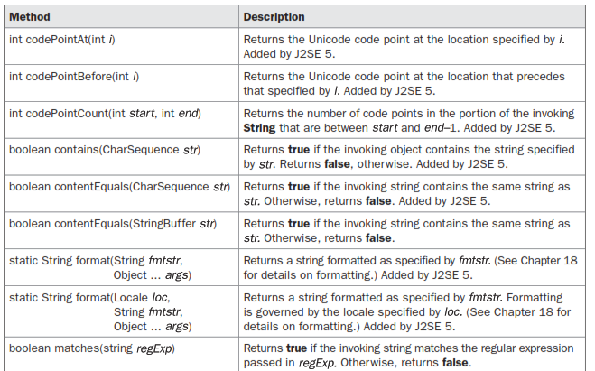
Additional String Methods

Slide 38
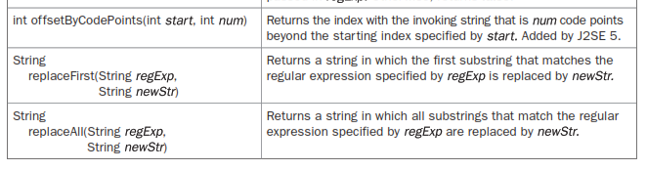
Additional String Methods(contd..)

Slide 39
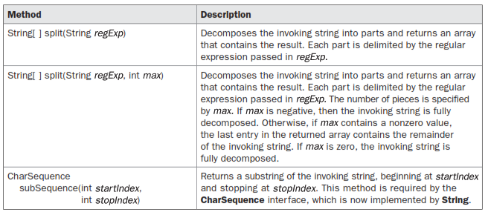
Additional String Methods(contd..)

Slide 40
StringBuffer
StringBuffer represents growable and writeable character sequences.
StringBuffer may have characters and substrings inserted in the middle or appended to the end.
StringBuffer will automatically grow to make room for additions and often has more spcaes preallocated.
Constructors:(explanation in program StringBufferConstructors)
StringBuffer( ) // Default size is 16 characters.
StringBuffer(int size)//string ex: StringBuffer(10) not StringBuffer(int 10)or StringBuffer(int h=10)
StringBuffer(String str) // String, with 16 characters extra. StringBuffer(“kkr”)//16+3==capacity
StringBuffer(CharSequence chars)

Slide 41
StringBuffer(contd..)
length( ) and capacity( )
The current length of a StringBuffer can be found via the length( ) method,
the total allocated capacity can be found through the capacity( ) method.
They have the following general forms:
int length( )
int capacity( )
Notes:
If capacity exceeds 16, then new capacity will be (old capacity*2)+2

Slide 42
StringBuffer(contd..)
length( ) and capacity( ) (Contd..)
// StringBuffer length vs. capacity.
class StringBufferDemo {
public static void main(String args[]) {
StringBuffer sb = new StringBuffer("Hello");
System.out.println("buffer = " + sb);
System.out.println("length = " + sb.length());
System.out.println("capacity = " + sb.capacity());
}
}

Slide 43
StringBuffer(contd..)
ensureCapacity( )
If you want to preallocate room for a certain number of characters after a StringBuffer has been constructed.
void ensureCapacity(int capacity)
capacity specifies the size of the buffer.
setLength( )
To set the length of the buffer within a StringBuffer object.
void setLength(int len)
len specifies the length of the buffer. This value must be nonnegative.

Slide 44
StringBuffer(contd..)
charAt( ) and setCharAt( )
The value of a single character can be obtained from a StringBuffer via the charAt( ) method. You can set the value of a character within a StringBuffer using setCharAt( ).
The general forms are:
char charAt(int where)
where specifies the index of the character being obtained.
void setCharAt(int where, char ch)
where specifies the index of the character being set.
ch specifies the new value of that character.
For both methods, where must be nonnegative and must not specify a location beyond the end of the buffer.

Slide 45
StringBuffer(contd..)
getChars( )
To copy a substring of a StringBuffer into an array, use the getChars( ) method.
General form:
void getChars(int sourceStart, int sourceEnd, char target[ ],int targetStart)
sourceStart specifies the index of the beginning of the substring.
sourceEnd specifies an index that is one past the end of the desired substring.
The array that will receive the characters is specified by target.
The index within target at which the substring will be copied is passed in targetStart.

Slide 46
StringBuffer(contd..)
append( )
The append( ) method concatenates the string representation of any other type of data to the end of the invoking StringBuffer object.
General Forms:
StringBuffer append(String str)
StringBuffer append(int num)
StringBuffer append(Object obj)
String.valueOf( ) is called for each parameter to obtain its string representation. The result is appended to the current StringBuffer object.
The append( ) method is most often called when the + operator is used on String objects. Java automatically changes modifications to a String instance into similar operations on a StringBuffer instance. Thus, a concatenation invokes append( ) on a StringBuffer object. After the concatenation has been performed, the compiler inserts a call to toString( ) to turn the modifiable StringBuffer back into a constant String.

Slide 47
StringBuffer(contd..)
append( ) (contd..)
// Demonstrate append().
class appendDemo {
public static void main(String args[]) {
String s;
int a = 42;
StringBuffer sb = new StringBuffer(40);
s = sb.append("a = ").append(a).append("!").toString();
System.out.println(s);
}
}
Output: a = 42!

Slide 48
StringBuffer(contd..)
insert( )
The insert( ) method inserts one string into another. It is overloaded to accept values of all the simple types, plus Strings, Objects, and CharSequences.
Like append( ), it calls String.valueOf( ) to obtain the string representation of the value it is called with.
General Form
StringBuffer insert(int index, String str)
StringBuffer insert(int index, char ch)
StringBuffer insert(int index, Object obj)
index specifies the index at which point the string will be inserted into the invoking StringBuffer object.

Slide 49
StringBuffer(contd..)
insert( ) (contd..)
// Demonstrate insert().
class insertDemo {
public static void main(String args[]) {
StringBuffer sb = new StringBuffer("I Java!");
sb.insert(2, "like ");
System.out.println(sb);
}
}
Output: I like Java!

Slide 50
StringBuffer(contd..)
Reverse()
You can reverse the characters within a StringBuffer object using reverse( ).
StringBuffer reverse( )
This method returns the reversed object on which it was called.
// Using reverse() to reverse a StringBuffer.
class ReverseDemo {
public static void main(String args[]) {
StringBuffer s = new StringBuffer("abcdef");
System.out.println(s);
s.reverse();
System.out.println(s);
}
}
Output: abcdef
fedcba

Slide 51
StringBuffer(contd..)
delete( ) and deleteCharAt( )
You can delete characters within a StringBuffer by using the methods delete( ) and deleteCharAt( ).
StringBuffer delete(int startIndex, int endIndex)
StringBuffer deleteCharAt(int loc)
startIndex specifies the index of the first character to remove.
endIndex specifies an index one past the last character to remove.

Slide 52
StringBuffer(contd..)
delete( ) and deleteCharAt( ) (contd..)
// Demonstrate delete() and deleteCharAt()
class deleteDemo {
public static void main(String args[]) {
StringBuffer sb = new StringBuffer("This is a test.");
sb.delete(4, 7);
System.out.println("After delete: " + sb);
sb.deleteCharAt(0);
System.out.println("After deleteCharAt: " + sb);
}
}
The following output is produced:
After delete: This a test.
After deleteCharAt: his a test.

Slide 53
StringBuffer(contd..)
replace( )
You can replace one set of characters with another set inside a StringBuffer object by calling replace( ).
StringBuffer replace(int startIndex, int endIndex, String str)
The substring being replaced is specified by the indexes startIndex and endIndex.
substring at startIndex through endIndex–1 is replaced. The replacement string is passed in str.
The resulting StringBuffer object is returned.

Slide 54
StringBuffer(contd..)
replace( ) (contd..)
// Demonstrate replace()
class replaceDemo {
public static void main(String args[]) {
StringBuffer sb = new StringBuffer("This is a test.");
sb.replace(5, 7, "was");
System.out.println("After replace: " + sb);
}
}
Here is the output:
After replace: This was a test.

Slide 55
StringBuffer(contd..)
substring( )
You can obtain a portion of a StringBuffer by calling substring( ). It has the following two forms:
String substring(int startIndex)
String substring(int startIndex, int endIndex)
The first form returns the substring that starts at startIndex and runs to the end of the invoking StringBuffer object.
The second form returns the substring that starts at startIndex and runs through endIndex–1. These methods work just like those defined for String.

Slide 56
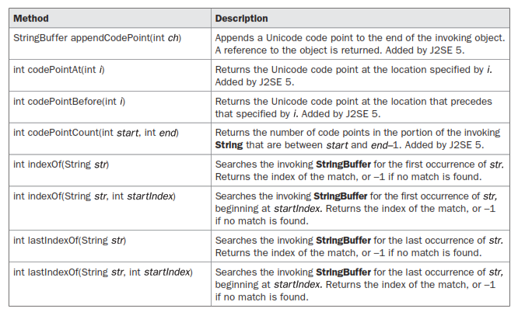
StringBuffer(contd..)
Additional String Buffer Methods.

Slide 57
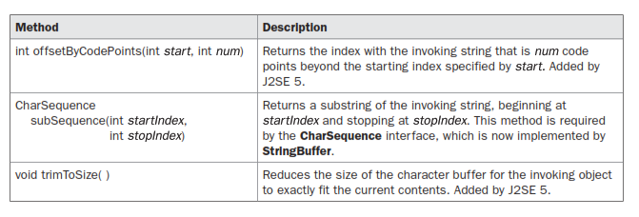
StringBuffer(contd..)
Additional String Buffer Methods.

